Slide 1

We Wish for More Sales
By Natalia Walls, Alexa Ott, Deautaun Ross

Slide 2
Target Audience
Marketing Department of Wish
Find out how to maximize profits
Figure out the features of good vendors
Online Vendors at Wish
Sell more products
Gain customers and customer loyalty
What items are popular

Slide 3
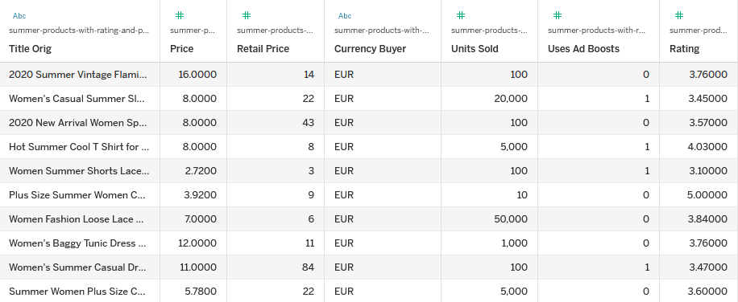
General Data Overview
1573 rows
Variation of a single product
(e.g. small black v-neck)
43 columns
We focused on ratings, pricing, shipping, and product colors
All sales from July 2020

Slide 4
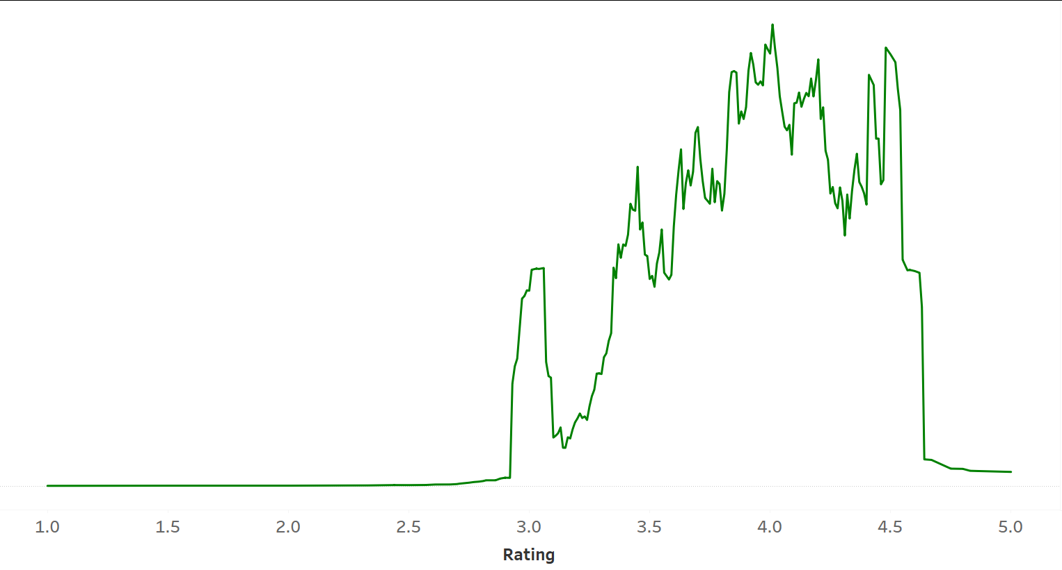
Initial Exploration: Rating vs. Rating Count
Most of the ratings were between 3 and 4.5 stars
Ratings outside this range only have a count of 1 or 2
Notes:
I feel like a big takeaway here is that a 5 star rating doesn’t actually mean anything

Slide 5
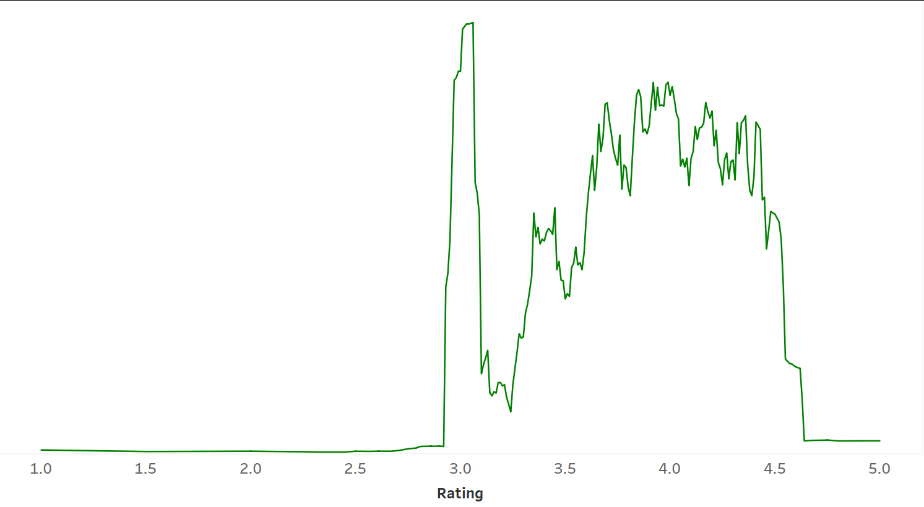
Initial Exploration: Rating vs. Average Revenue
Revenue created by multiplying Price by Units Sold
High ratings does not necessarily mean high revenue
Notes:
People tend to leave reviews when negative
Rating ultimately doesn’t, matter except for the customer
Ratings higher than 4.5 only have low revenues due to fewer ratings overall

Slide 6
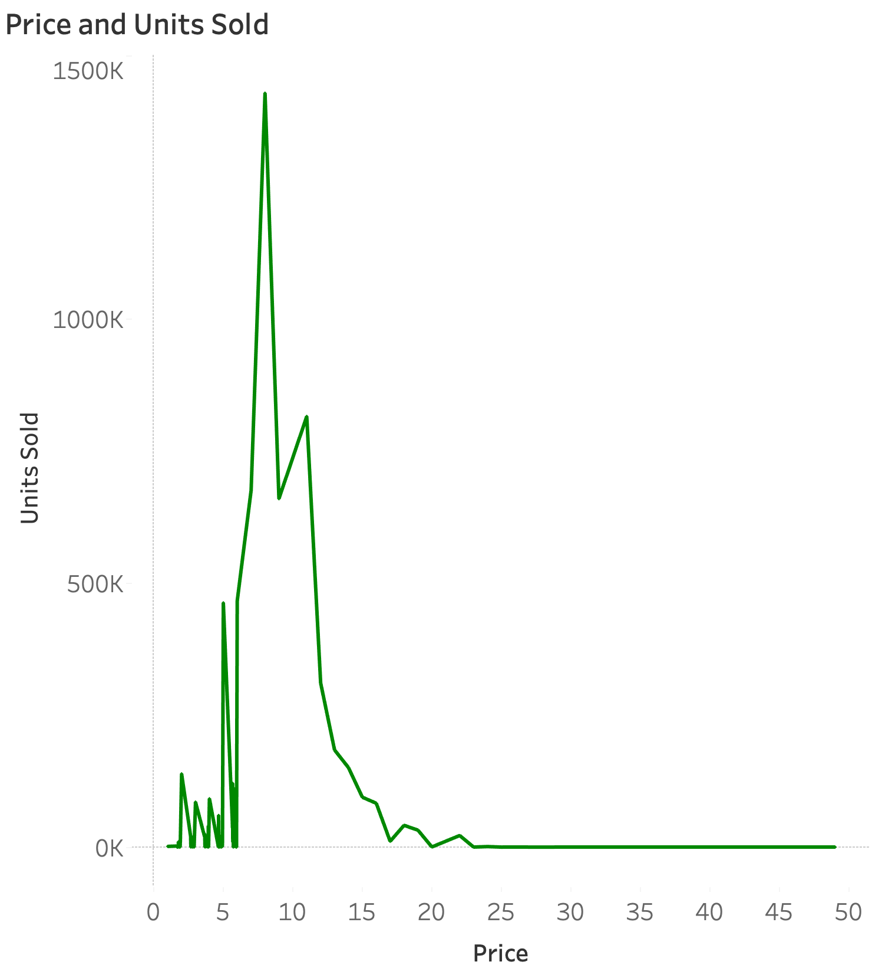
Initial Exploration: Pricing
Most items sold were priced between 5€ to 15€

Slide 7
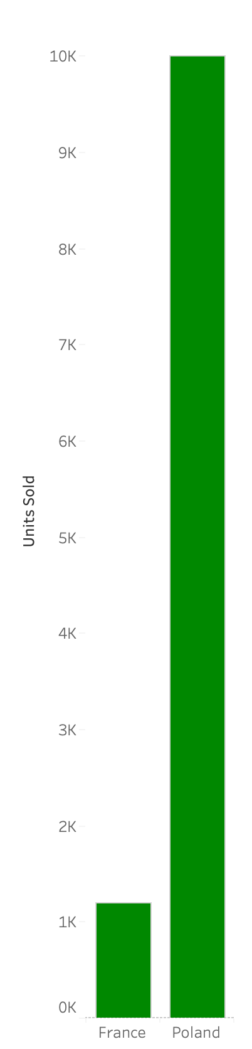
Express Shipping Price and Units Sold
Because it’s an ecommerce site, shipping is required
People like getting their items quick
Only available in France and Poland
Average Price in France: 24€
Average Price in Poland: 6€
Express shipping is chosen only when not too expensive.
Notes:
Include price rating if possible

Slide 8
Finding How Product Color Affects Profit
Profit is a Calculated field:
Average Profit:
[AVG Retail Price] - [AVG Price]
Sum Profit
[SUM Retail Price] - [SUM Price]

Slide 9
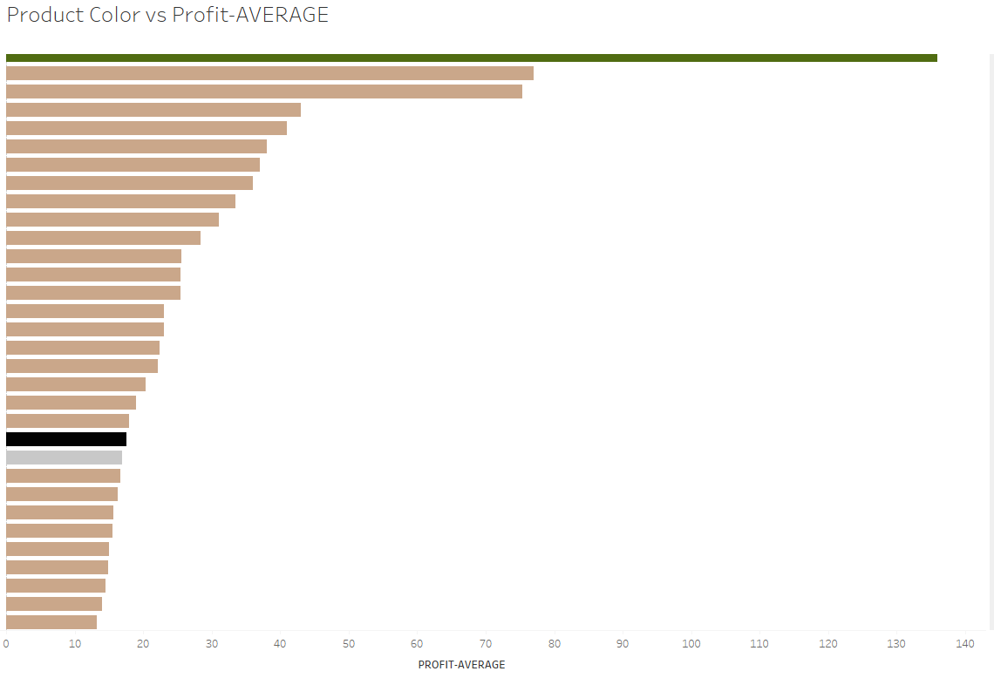

Slide 10
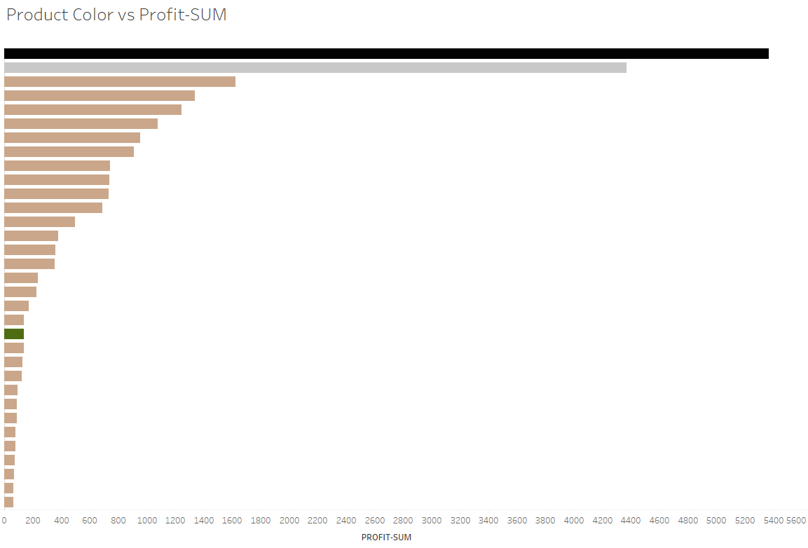

Slide 11
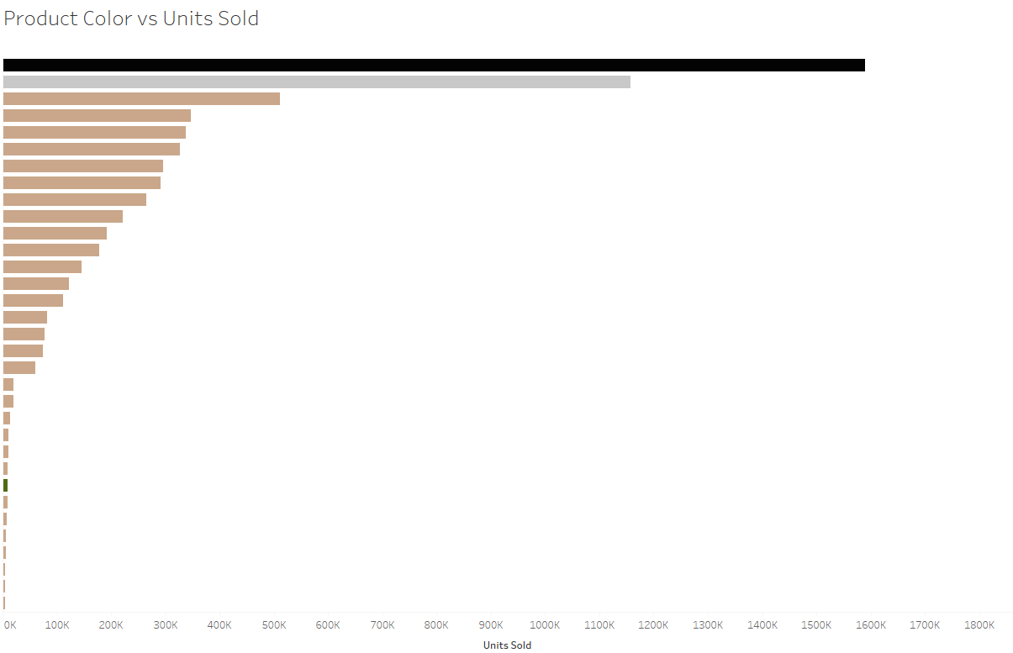
1,589,313
1,158,227
10,000

Slide 12
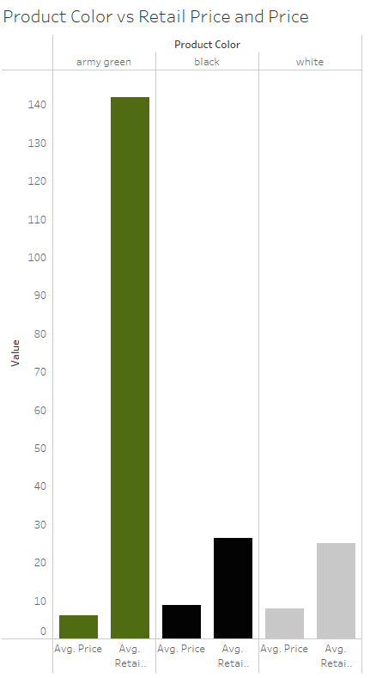
Wish.com is selling Army Green at a way higher price compared to what they bought it at
This is because of trends happening in summer of 2020

Slide 13
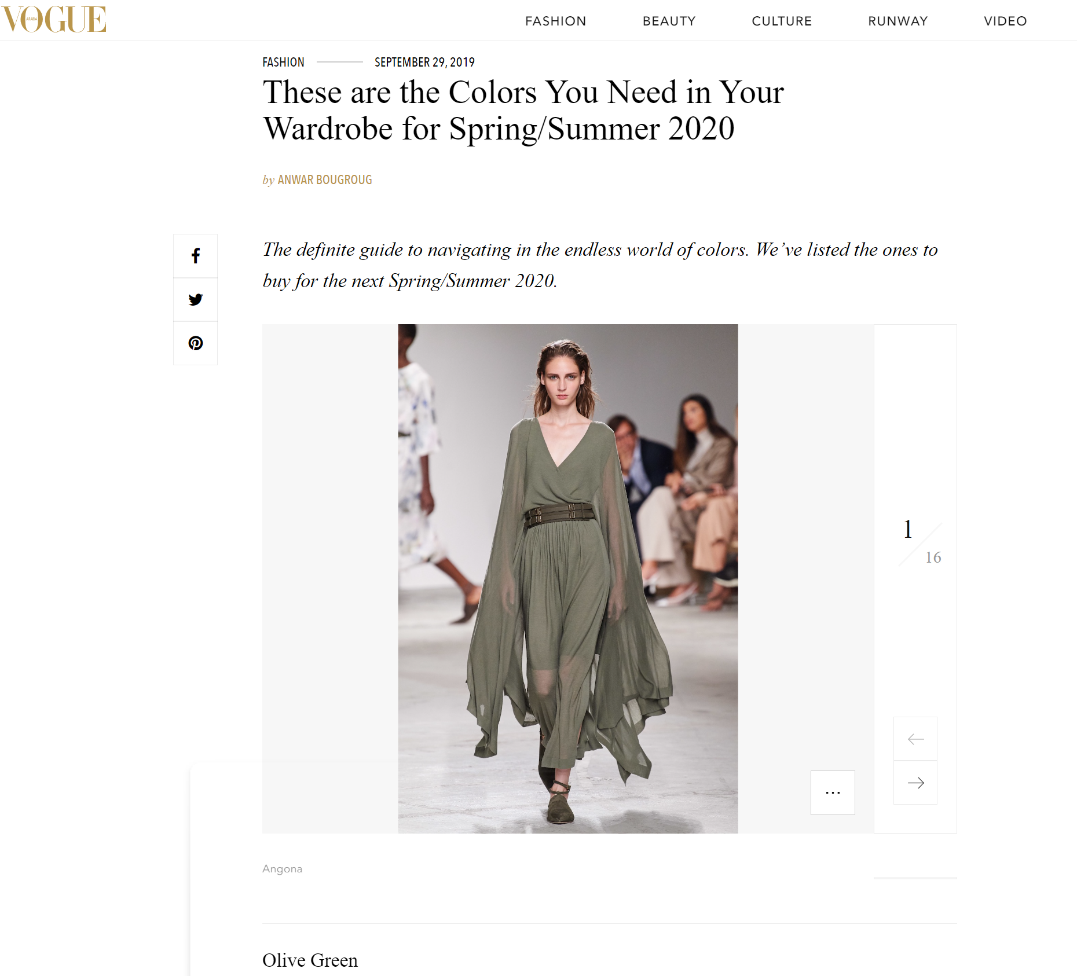

Slide 14
Main Takeaways
5 star ratings don’t indicate high revenue
Keep shipping prices low
Wish doesn’t cater to “big spenders”
Keep some staples as they sell year-round
Paying attention to what is trending and get ahead of it

Slide 15
Thank You!

Slide 16
Extra Stuff

Slide 17
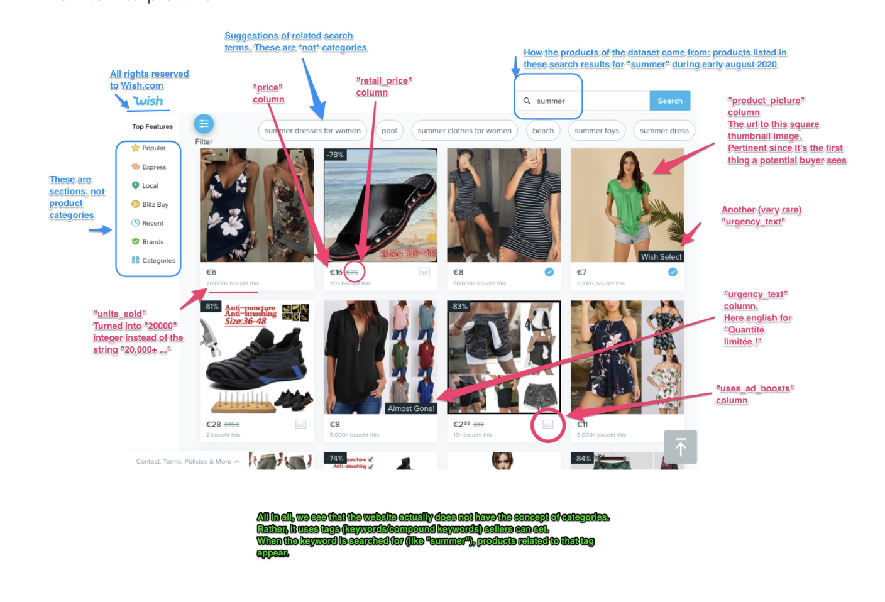

Slide 18
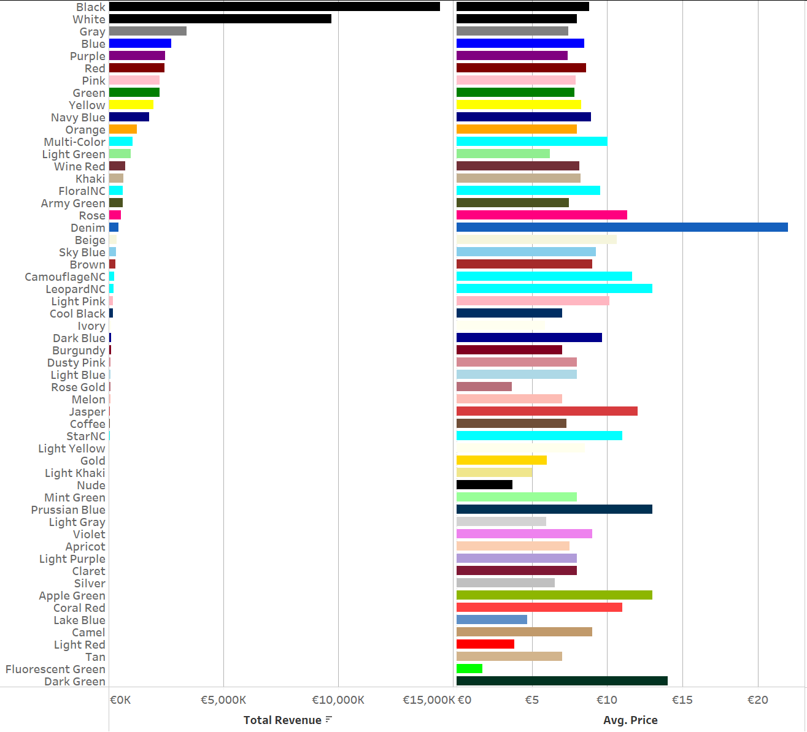

Slide 19
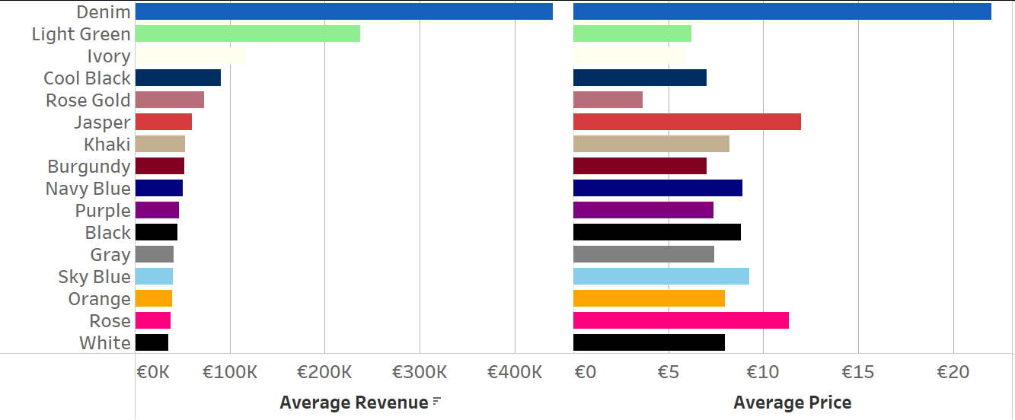
Average Revenue & Price vs. Color
Note: average rating count filter > 500
Notes:
Black and white cloths are staples (never go out of style)
Army green was a trend at this time

Slide 20
Finding Important Columns
Out of the 43 columns, only 6 mostly matter:
Price
Units Sold
Rating
Rating Count
Shipping Option Price
Countries Shipped To
Color

Slide 21
Target Audience (not part of final presentation)
Audience: The marketing department
Purpose: Educate the department on how to maximize sales
Notes:
Audience: A presentation to the marketing department to help them better educate businesses on how to maximize their sales.
Also note that the data was collected in July 2020 (early into the pandemic)
Online clothes shoppers:
They want better quality products for lower price.
Online clothes vendors:
They want more shoppers that give good reviews.

Slide 22
Understanding Model (not part of final presentation)
Clothes shoppers will give low rating if clothes quality is low and price is high.
But, they will give high rating if
Clothes vendors will gain customers if their rates (quality + price) are good, and their clothes variety and rating is high. (ignoring markup, since it’s normally high)
But, they will lose customers if their rating is low

Slide 23
Model Assumptions (win-win goal)
High product rating, more customers are likely to buy it.
Low product price, more customers are likely to buy it.
Bigger product stock, more customers can buy it.
Bigger product variety, number of customers will increase.
(popularity determined through column, “units_sold”)

Slide 24
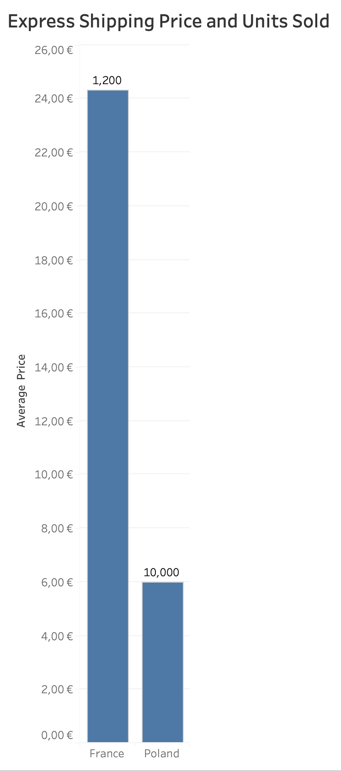
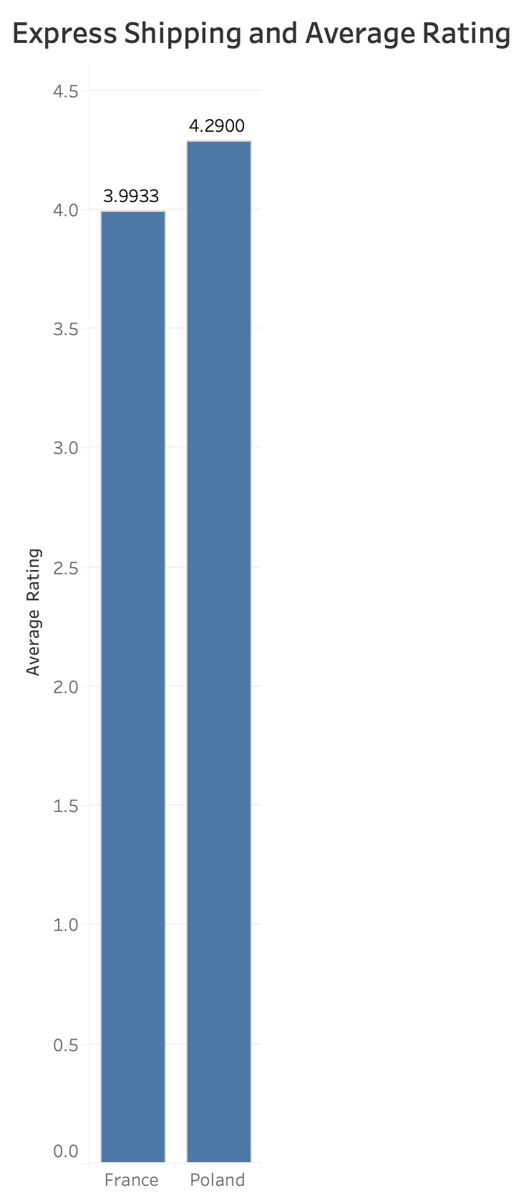
Express Shipping
Only available in France and Poland.
France was much more expensive, and sold less units.
France also had a slightly lower average rating.
Notes:
Maybe just mention the ratings in text?

Slide 25
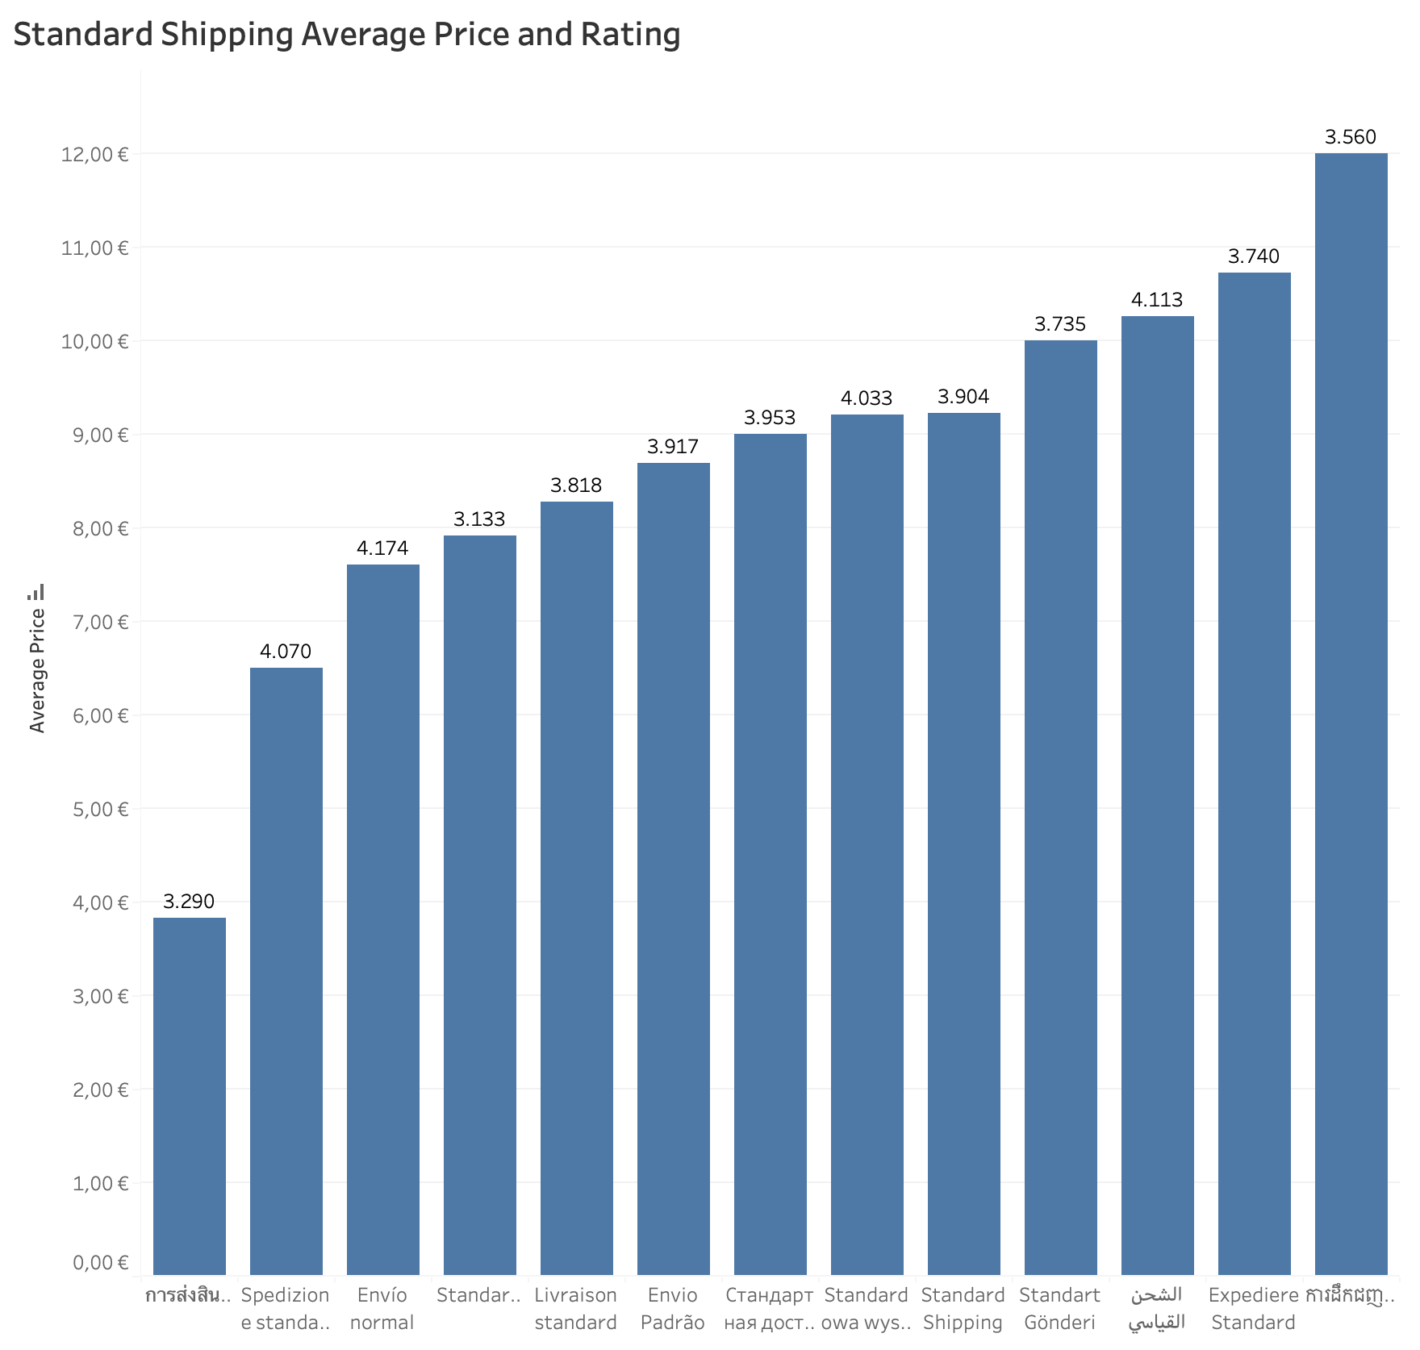
Standard Shipping
Most countries only had standard.
Lower prices, but also lower ratings.

Slide 26
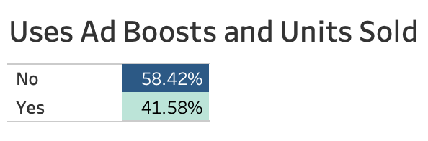
Ad Boosts
Notes:
Out of all units sold, about 58% were sold w/out ad boosts, and 42% with.

Slide 27
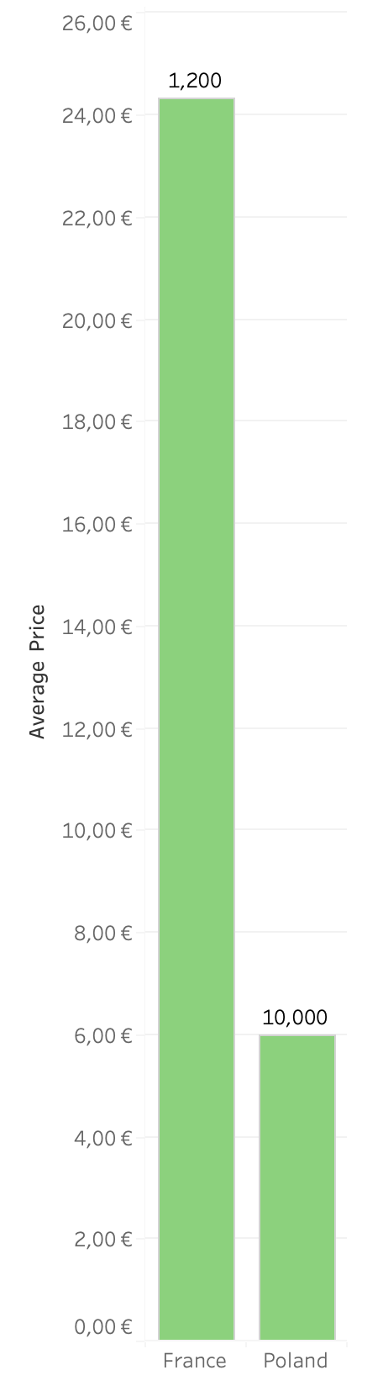
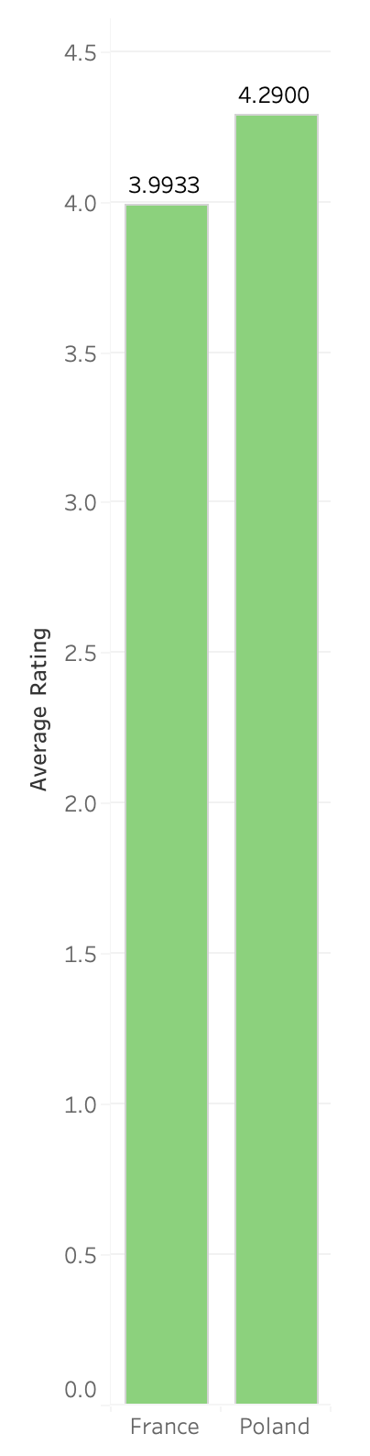
Express Shipping
Only available in France and Poland
France was much more expensive, and sold less units.
France: 1,200 Units Sold
Poland: had 10,000 Units Sold
Notes:
Include price rating if possible

Slide 28
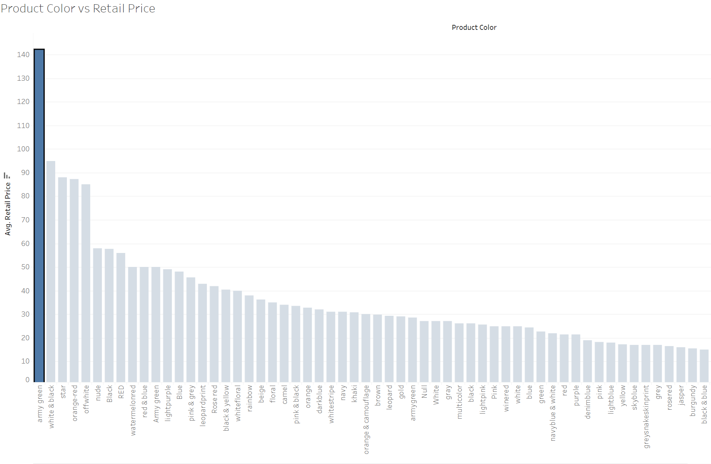
Comparing the Retail Price of Products by Color

Slide 29
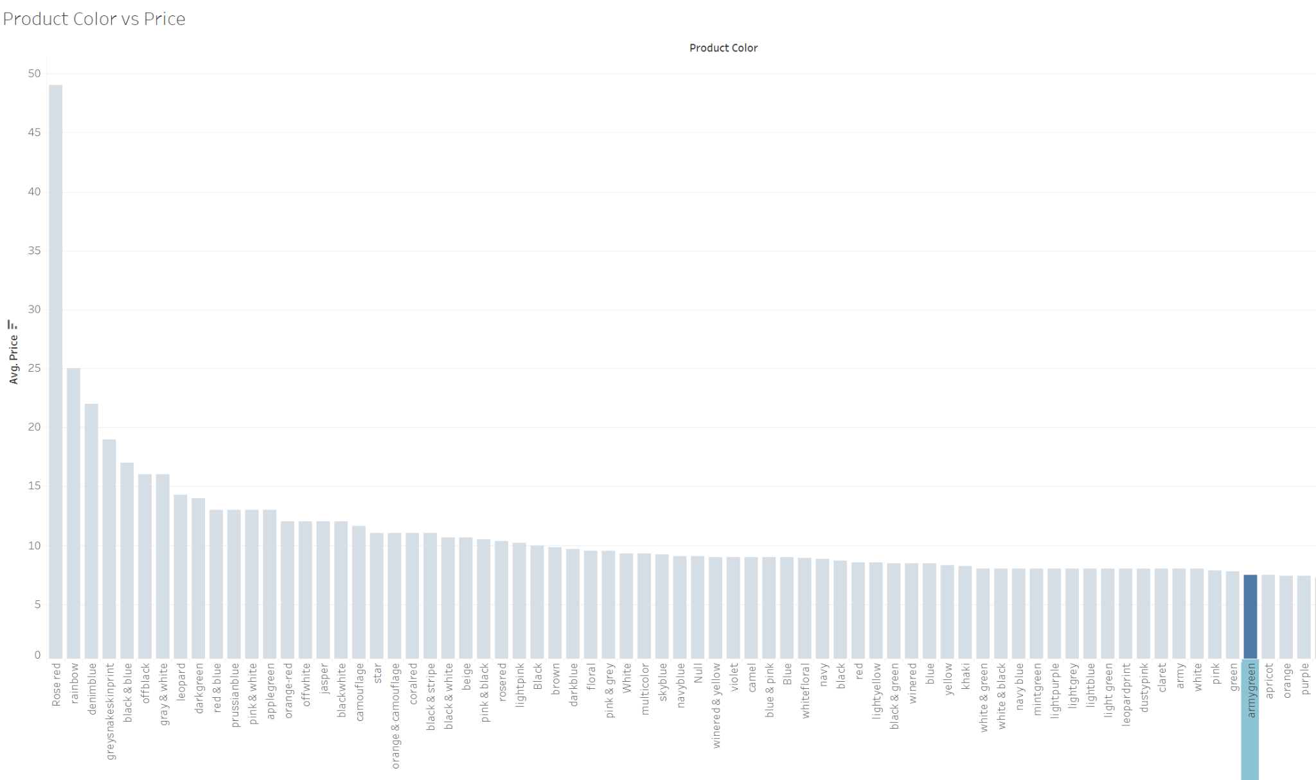
Comparing the Price of Products by Color

